Slide 1
CSP 571 PROJECT
Spring 2018
Cristina Fernandez Garcia
Pablo Medrano Gastañaga
Alvaro Gomez Hernandez
Ignacio Diez

Slide 2
Goal. Answer some questions related to the development of 5 countries
Spain, USA, India, France, China
Starting Point . World development indicators data frame
Methodology. Data Preparation + Data Exploration & Visualization + Modeling
Results
Future Lines

Slide 3
GOAL
Life expectancy evolution and its relation with other indicators.
Mortality related to contamination and economic development.
Gender equality evolution related with education and early fertility
Household consumption related with other macroeconomic indicators

Slide 4
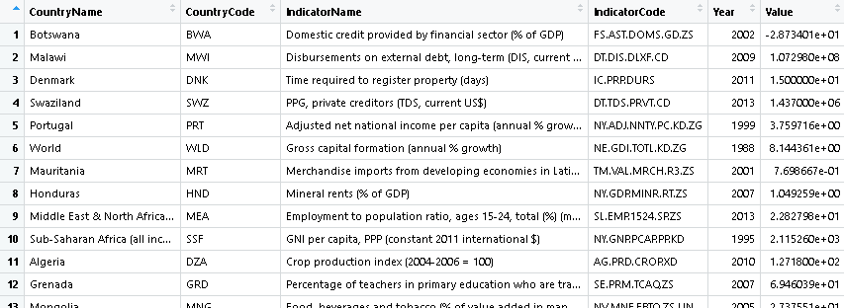
Starting Point
More than 5.5 Million of observables
1344 different indicators for 247 countries
Data from 1960 to 2015

Slide 5
Data Preparation
Create a Subset for each country and response to study.
Decide which of the indicators are, a priori, related with the response.
Include those indicators in the corresponding subset
Fix the missing data through Kalman smoothing

Slide 6
EXAMPLE OF THE PROCESS

Slide 7
RESULTS: Is the mortality related to the contamination?
Choose some indicators:
CO2 emissions (kt)
Methane emissions (kt of CO2 equivalent)
Forest area (sq. km)
GDP per capita (current US$)
Death rate, crude (per 1,000 people)
Mortality rate, adult, female (per 1,000 female adults)
Mortality rate, adult, male (per 1,000 male adults)

Slide 8
GRAPH OF EACH INDICATOR PER COUNTRY
Red points– imputed data with Kalman
Indicator with more than half of the years imputed are discarded

Slide 9
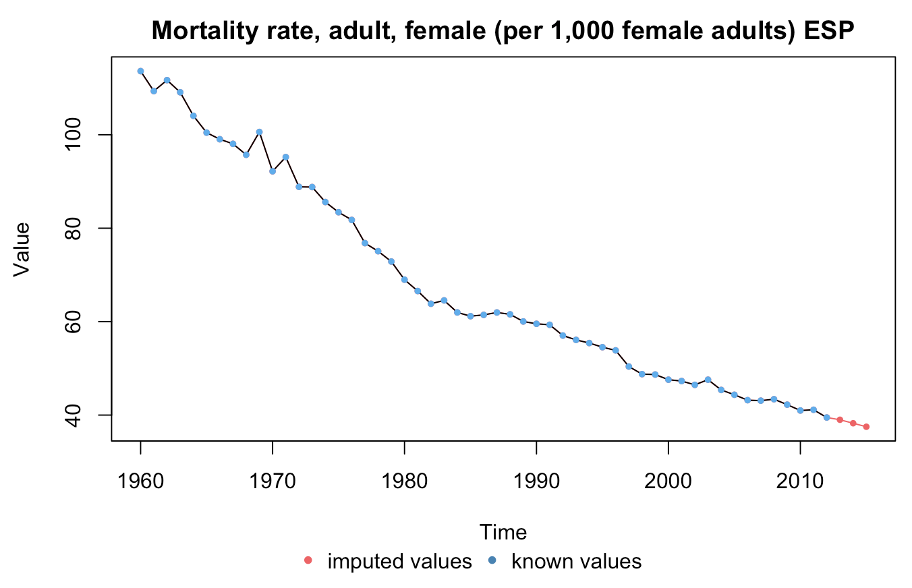
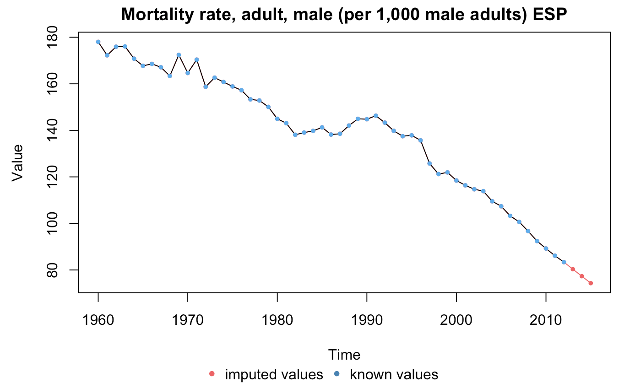
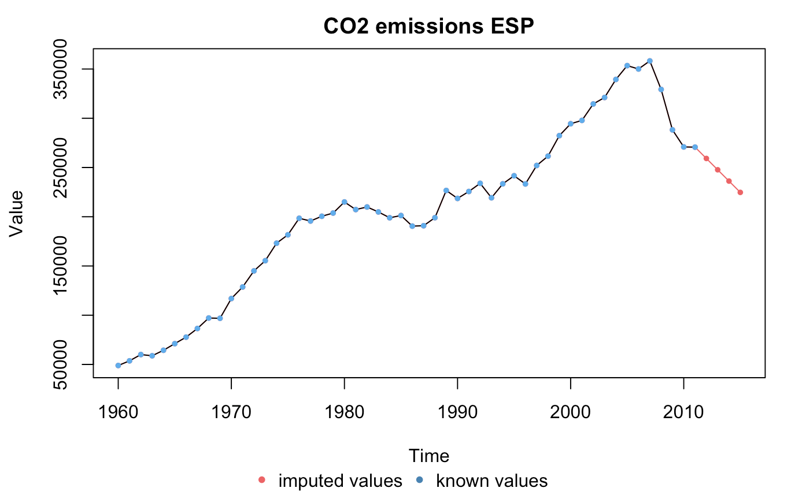
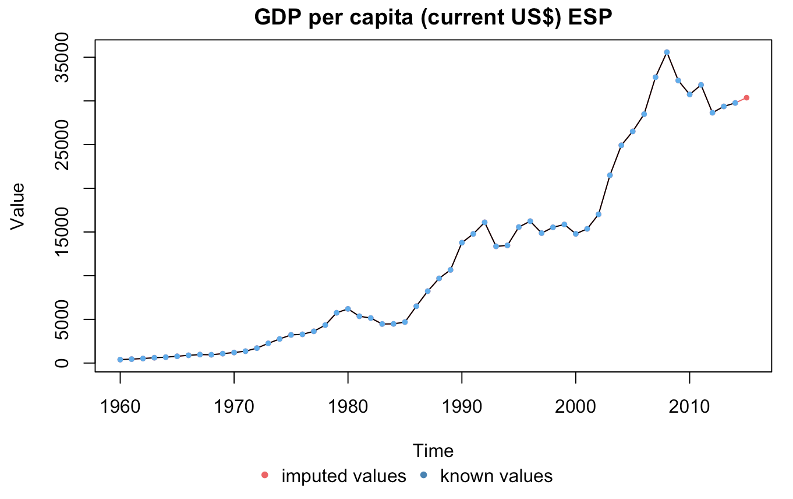
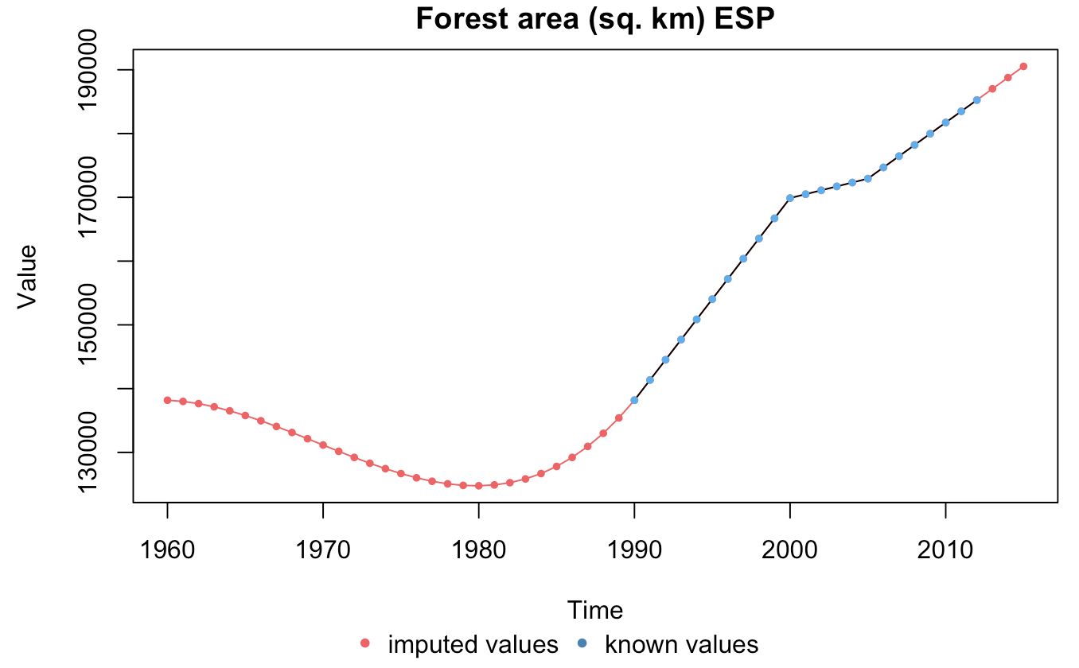
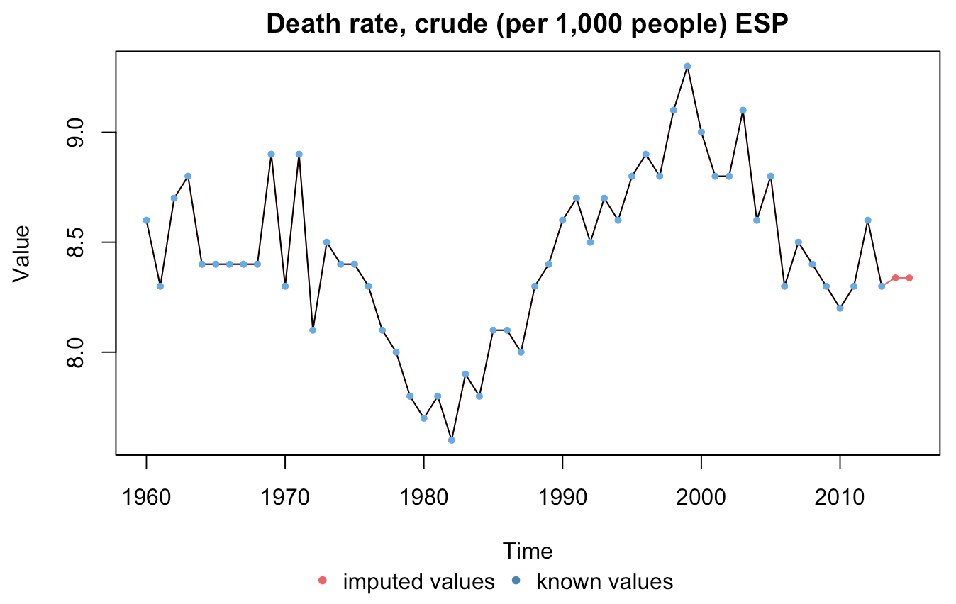
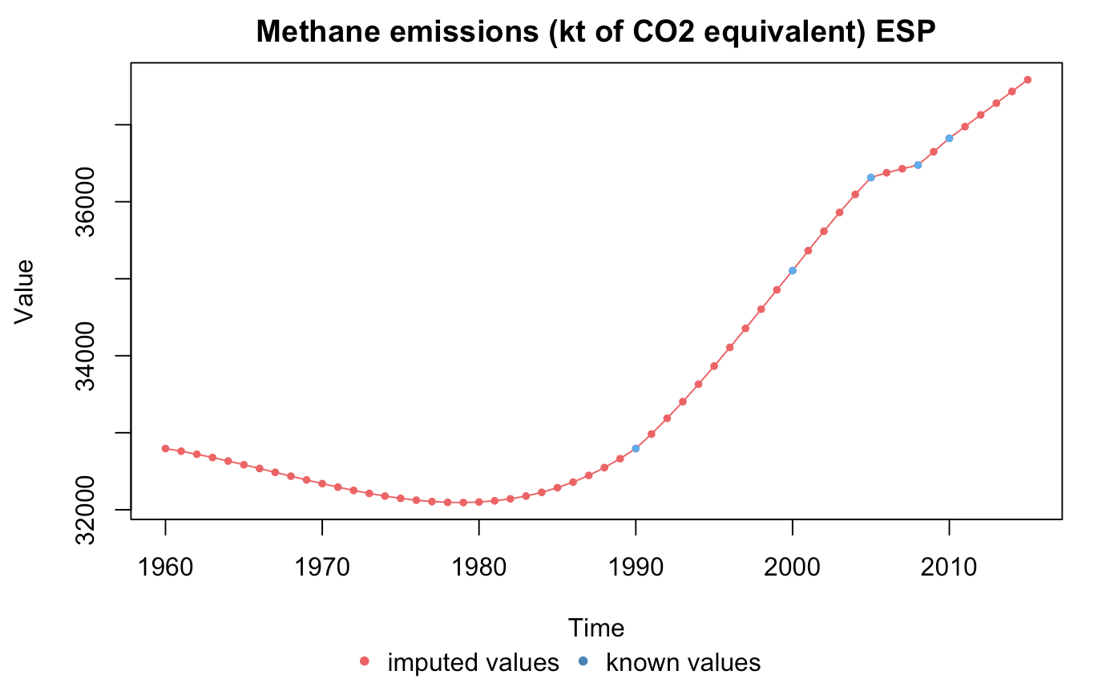
RESULTS:
SPAIN

Slide 10
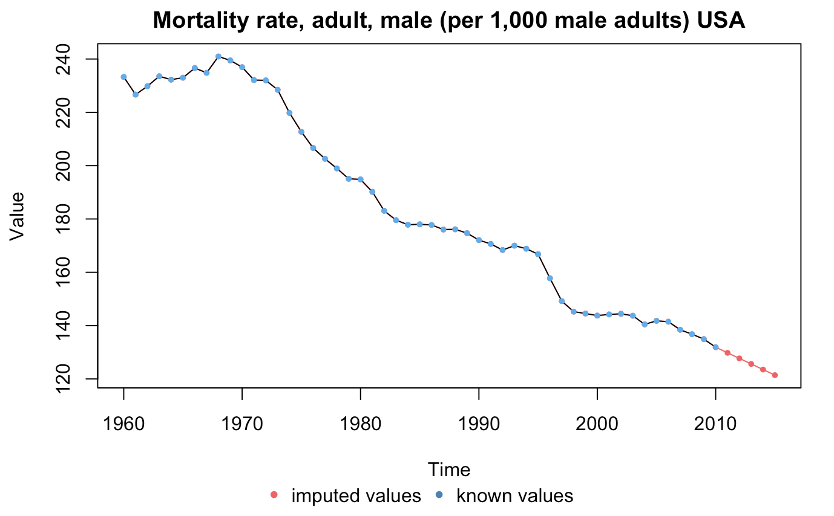
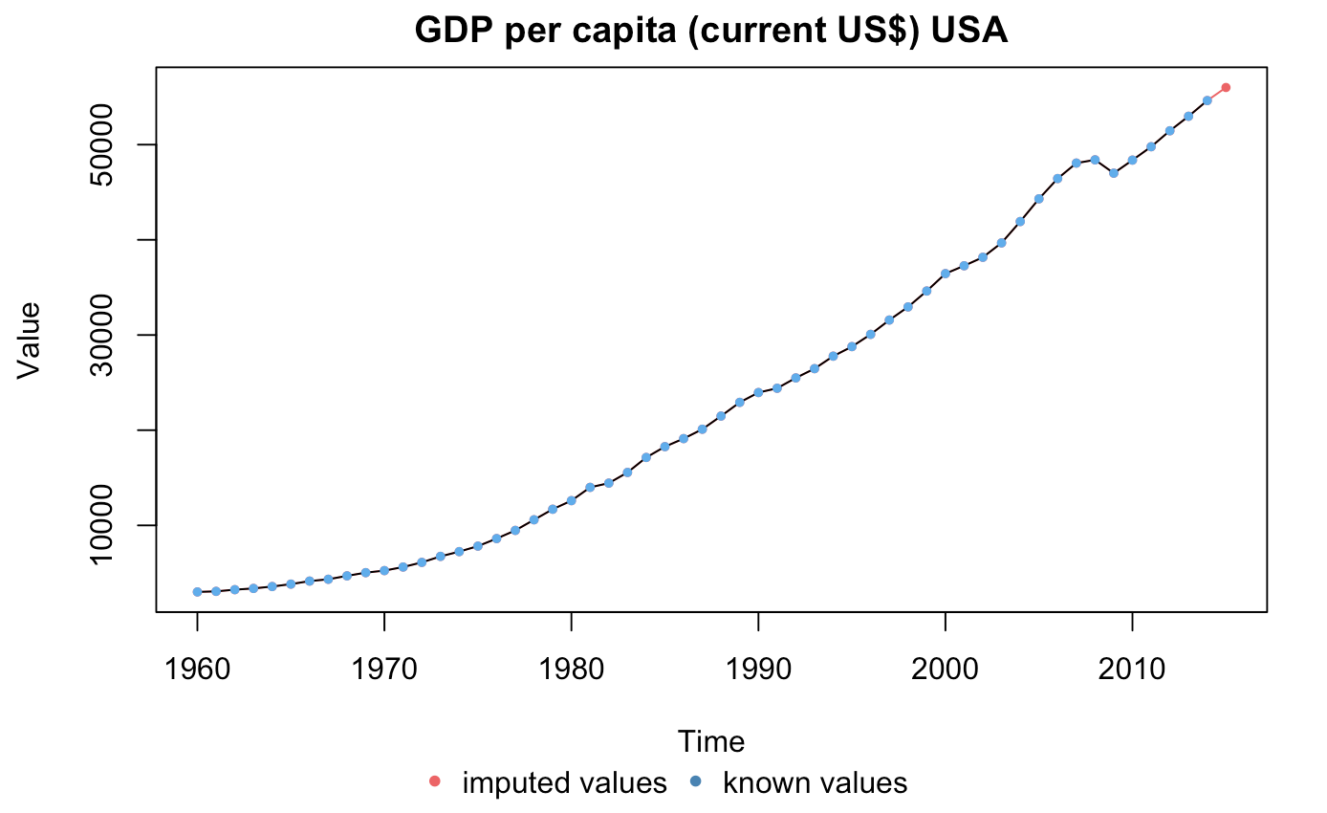
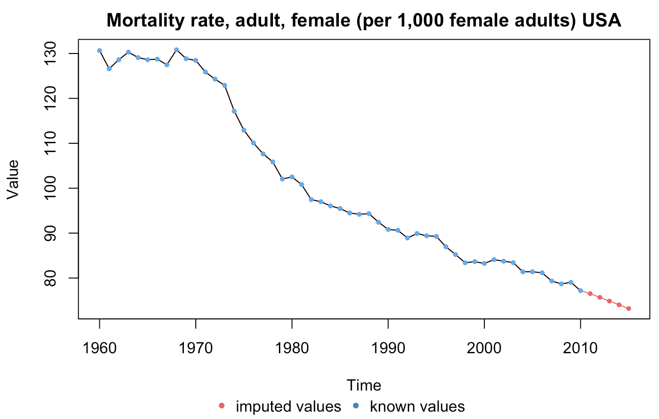
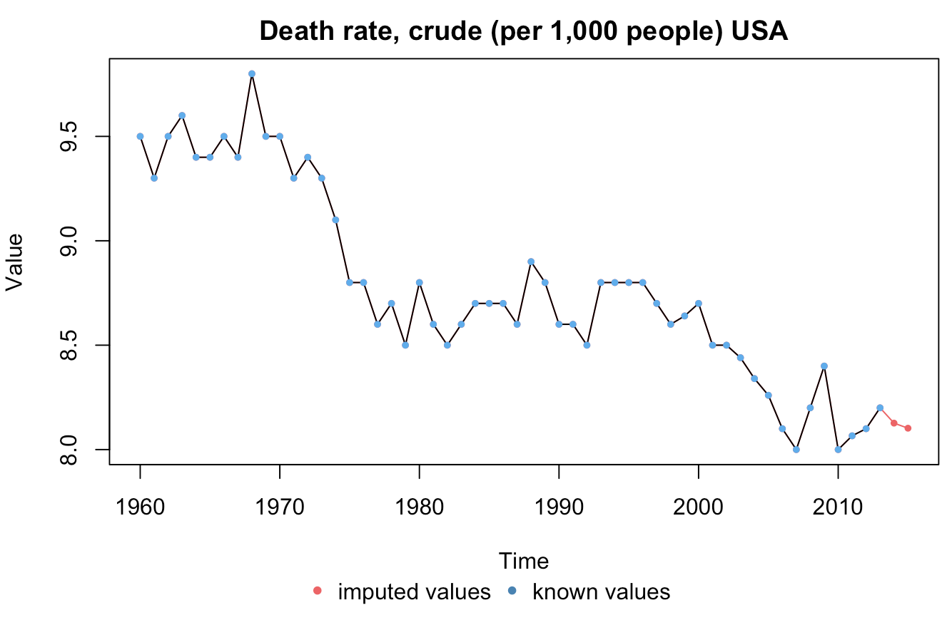
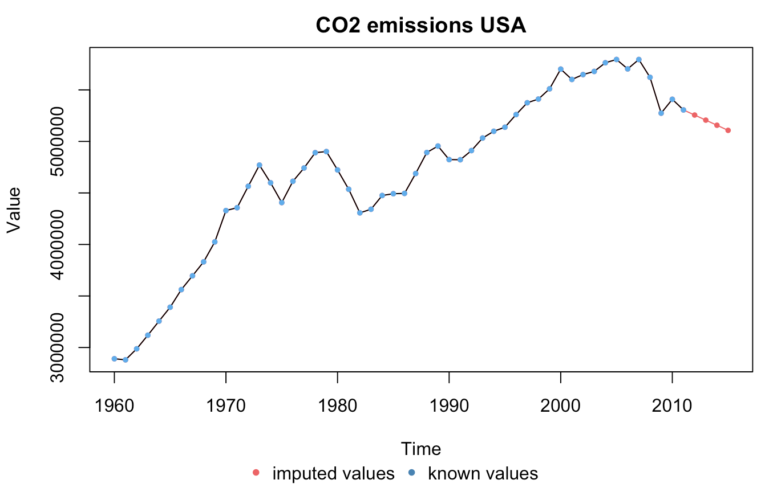
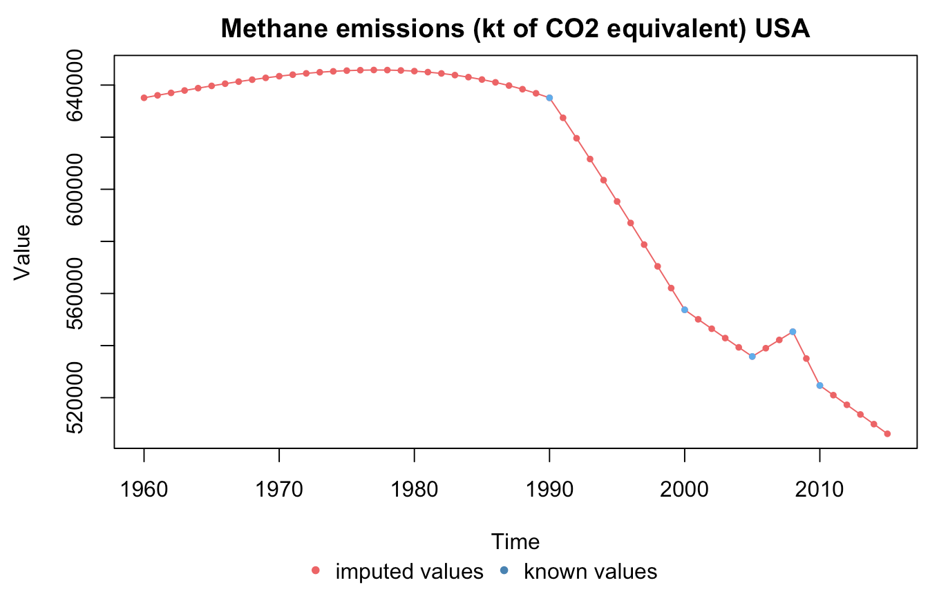
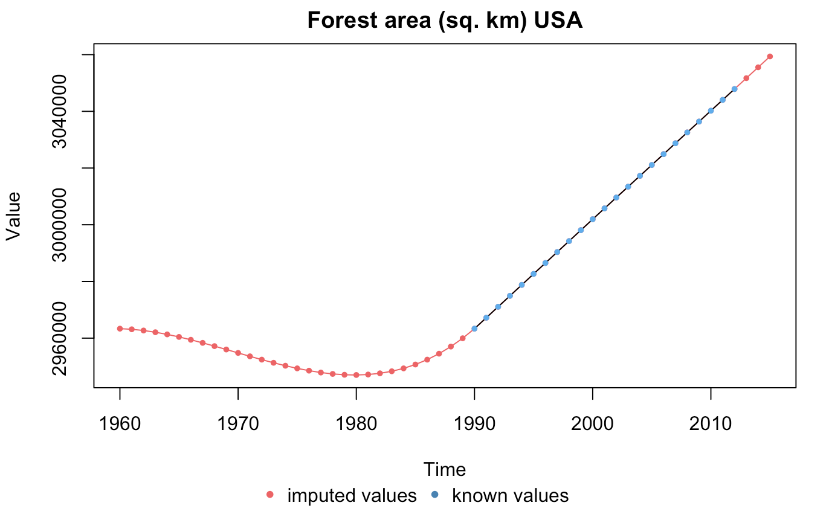
RESULTS:
USA

Slide 11
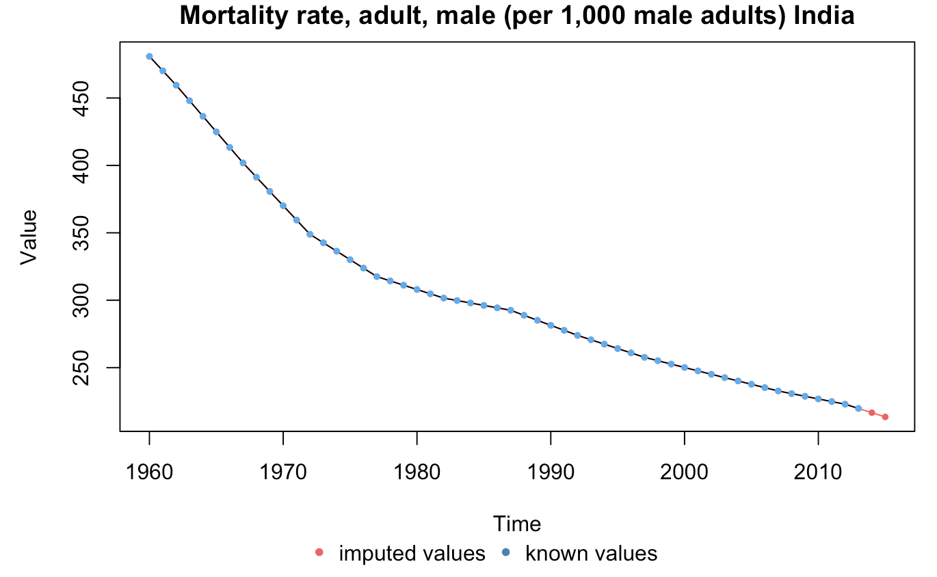
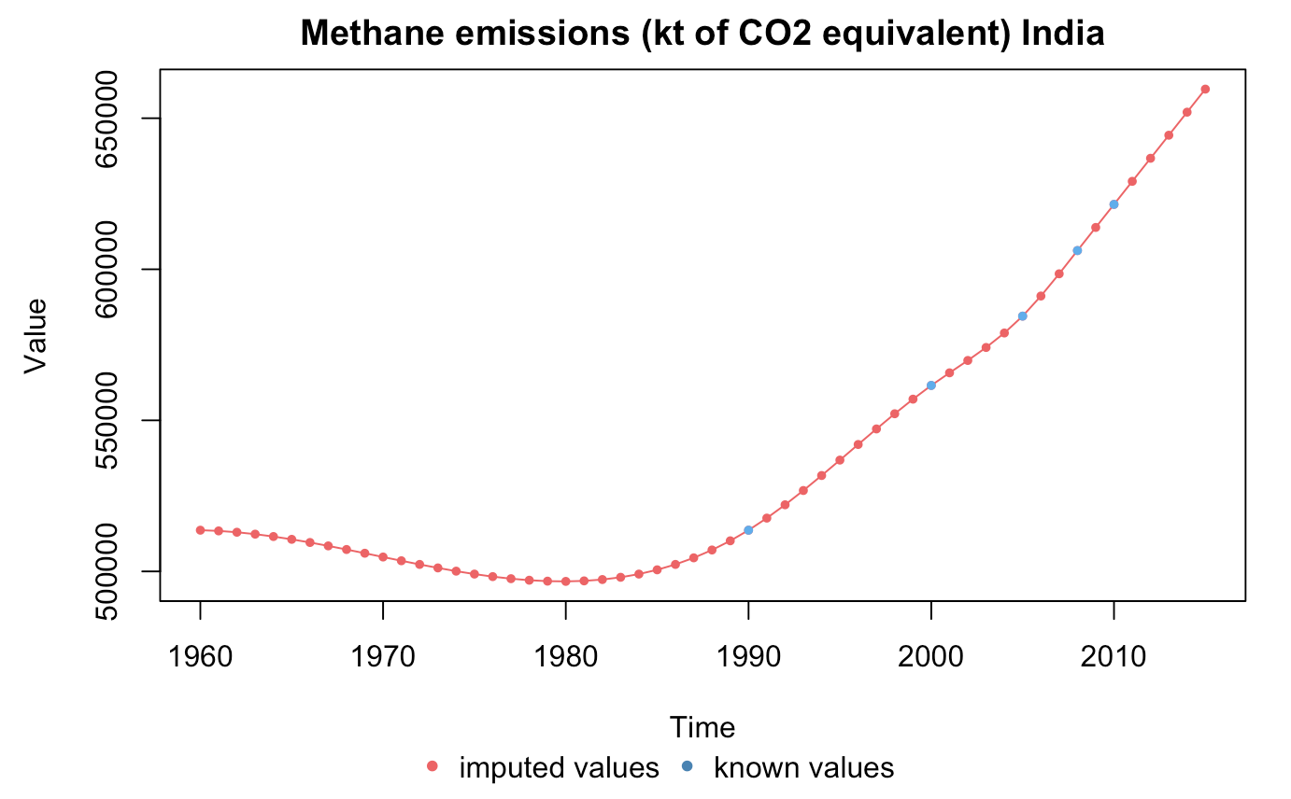
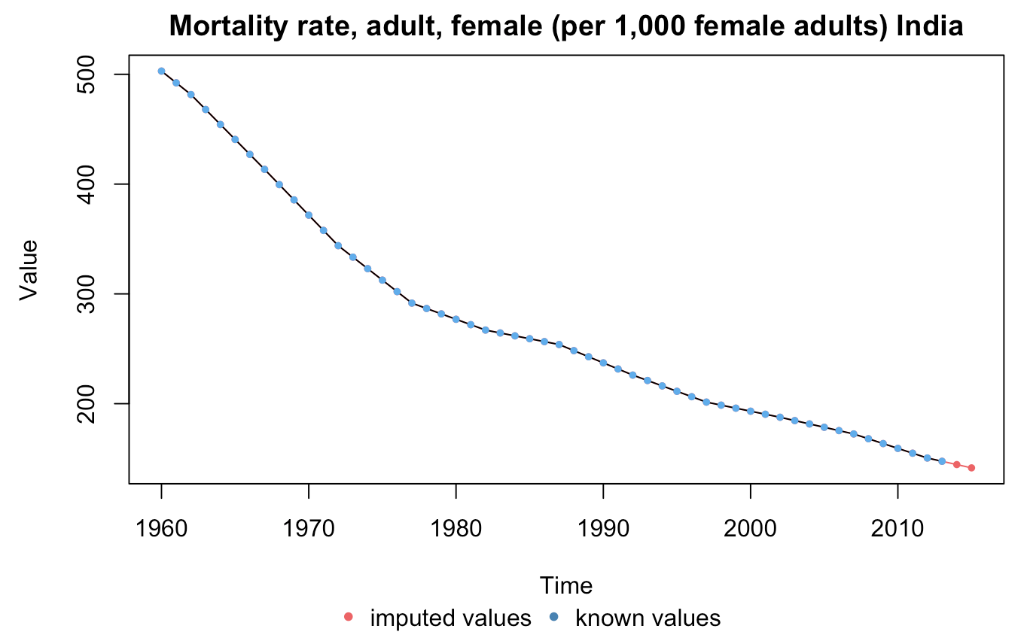
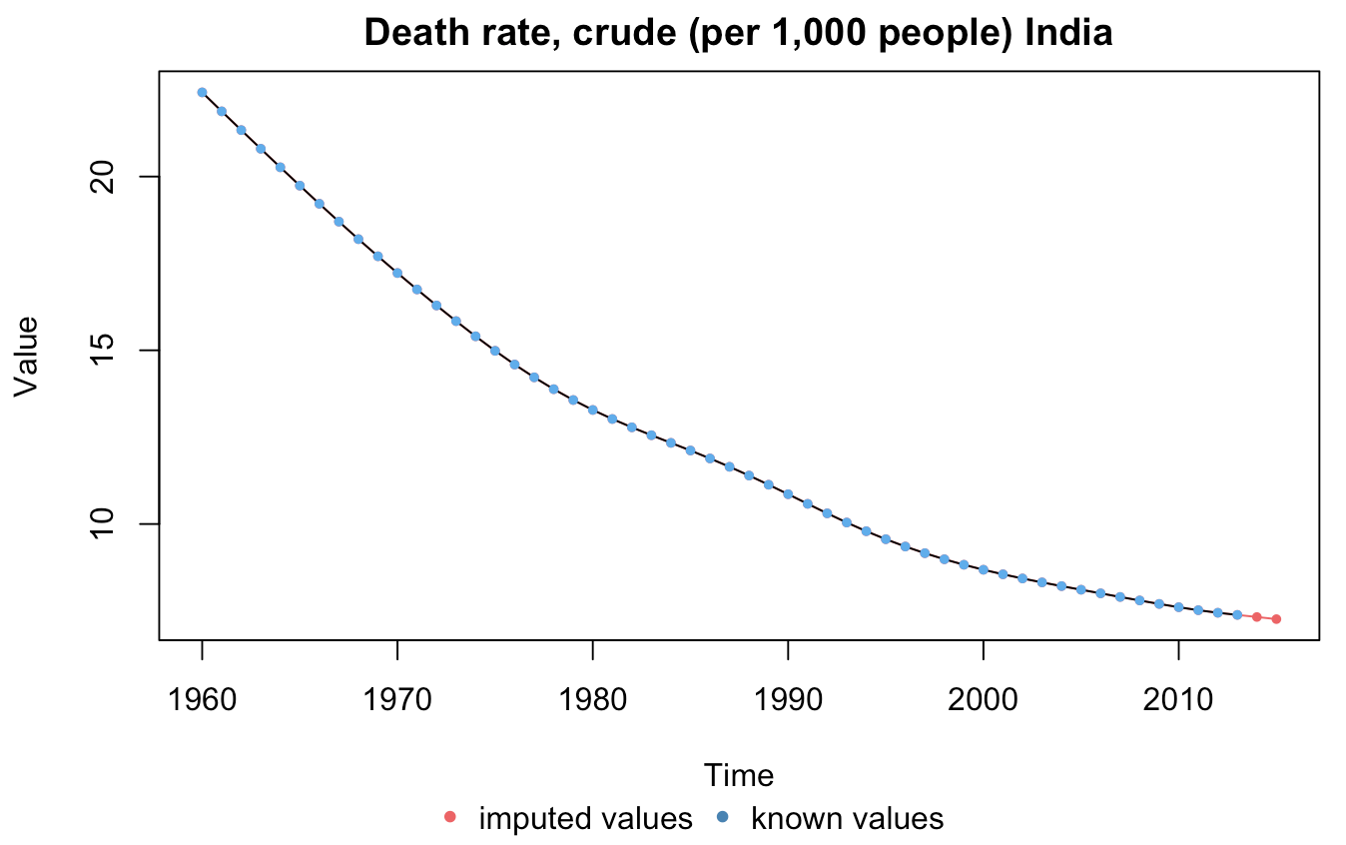
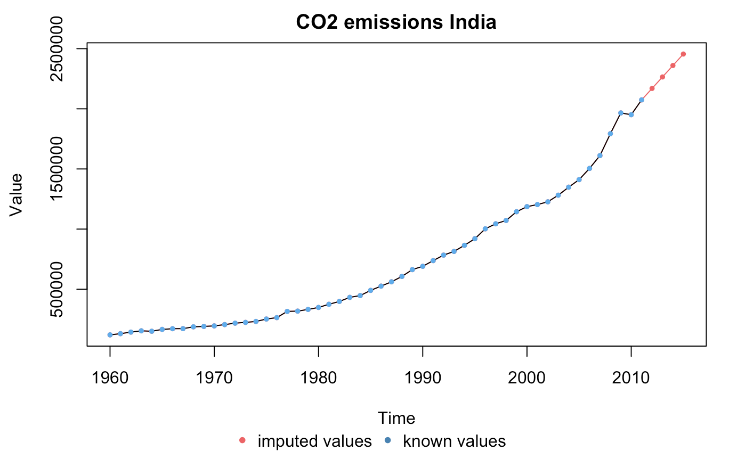
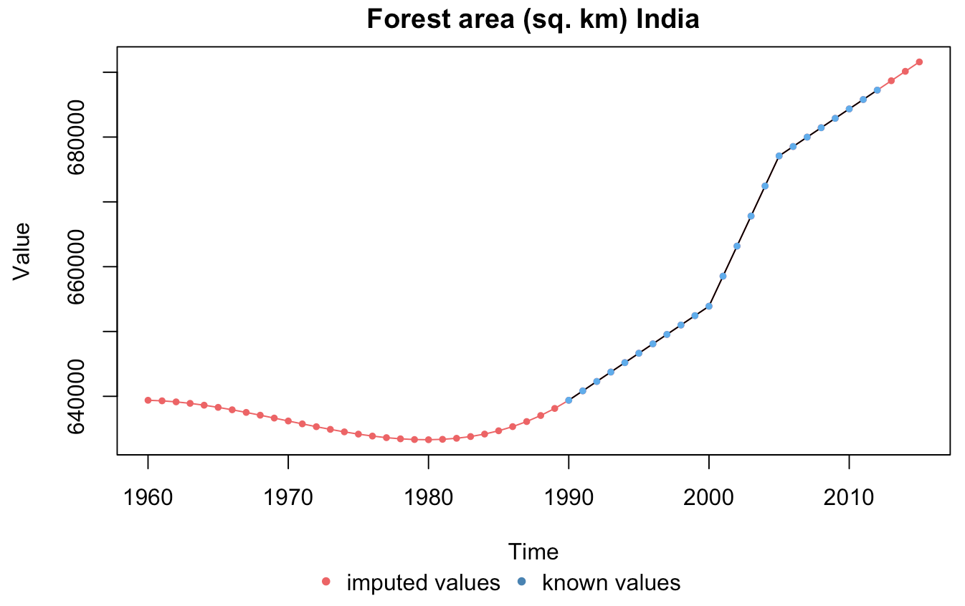
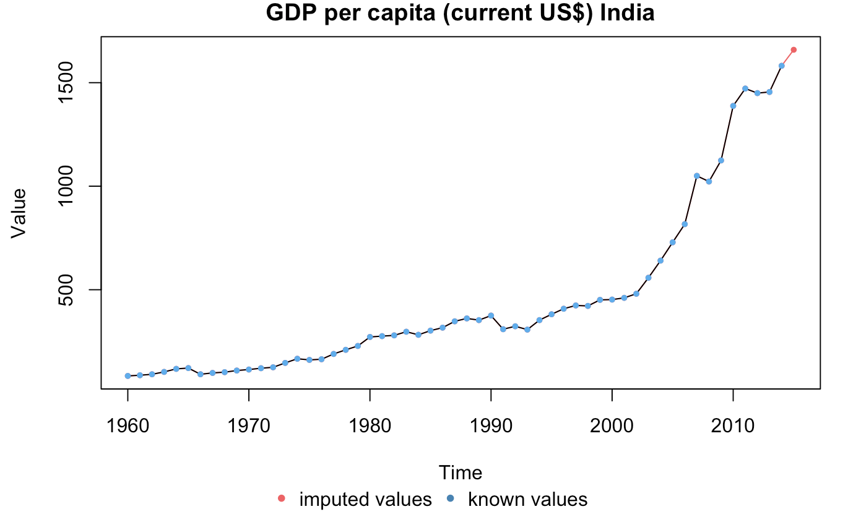
RESULTS:
INDIA

Slide 12
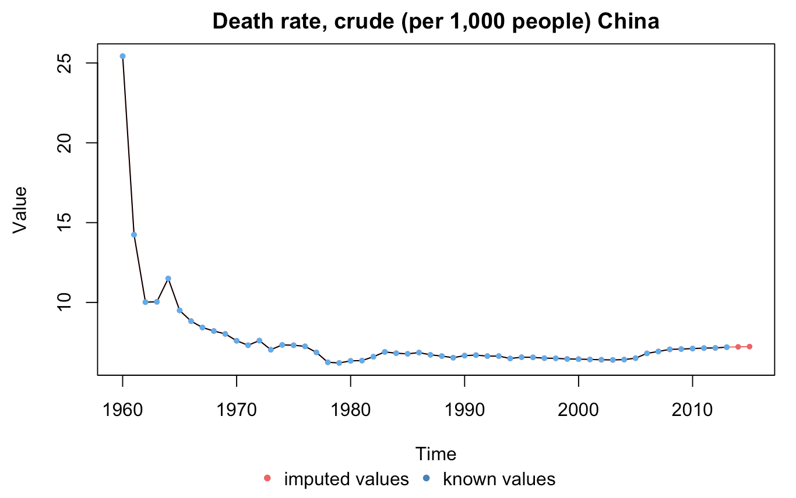
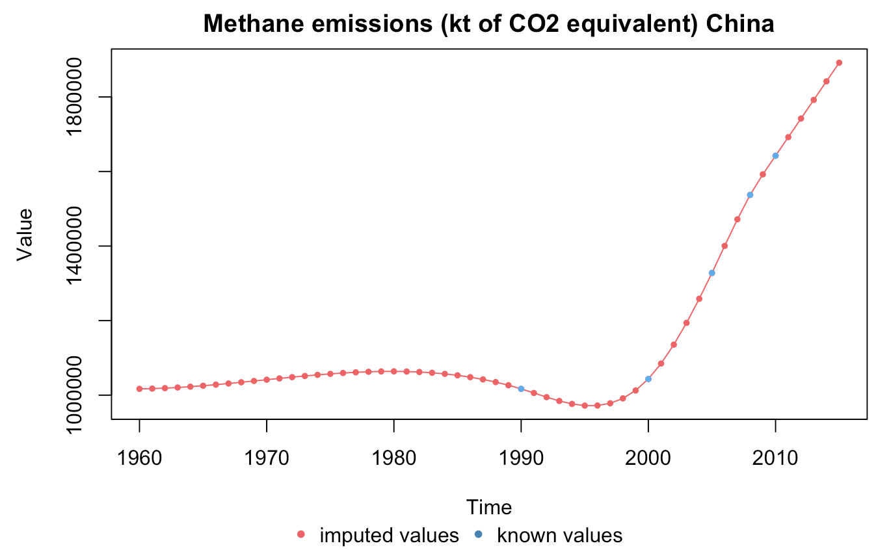
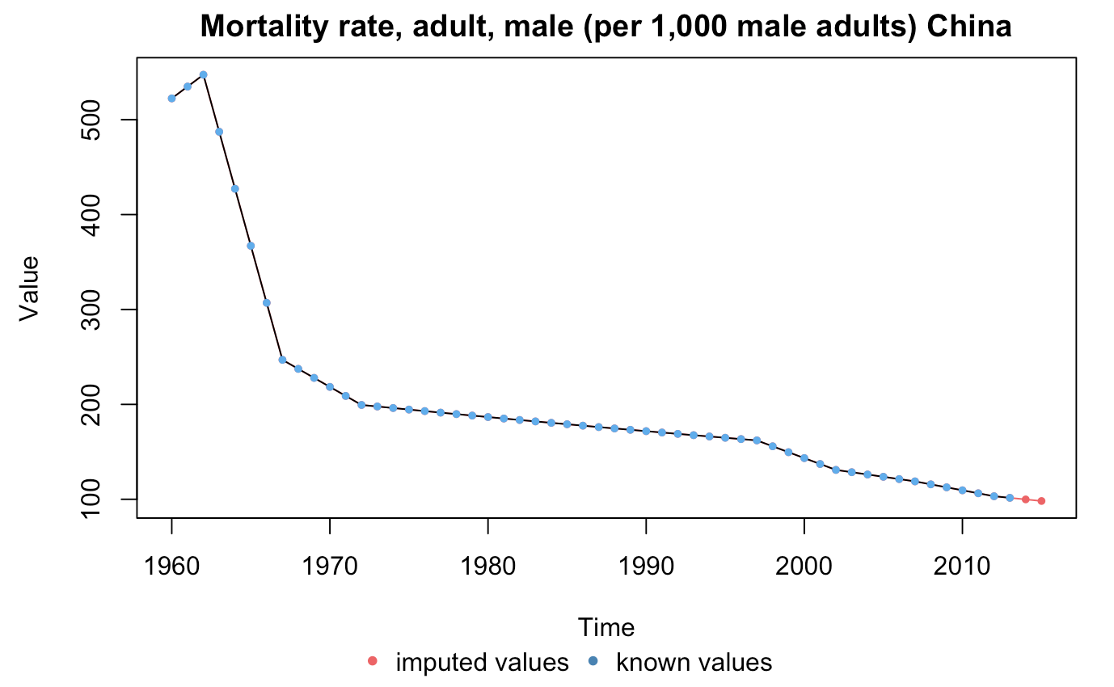
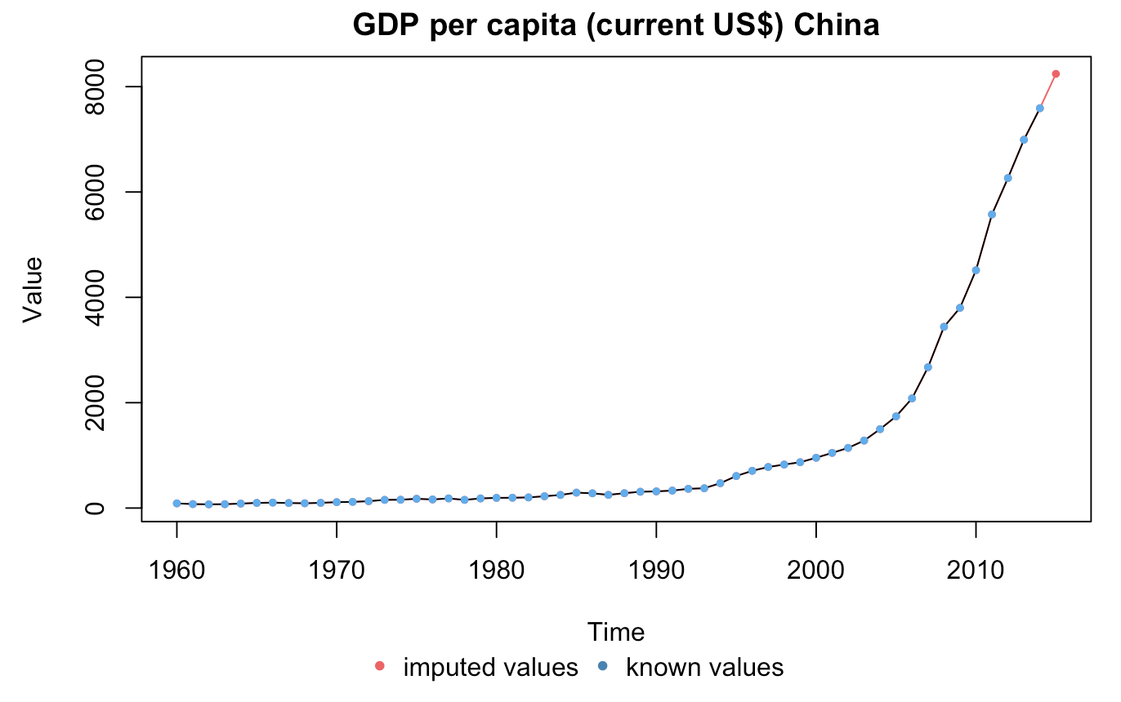
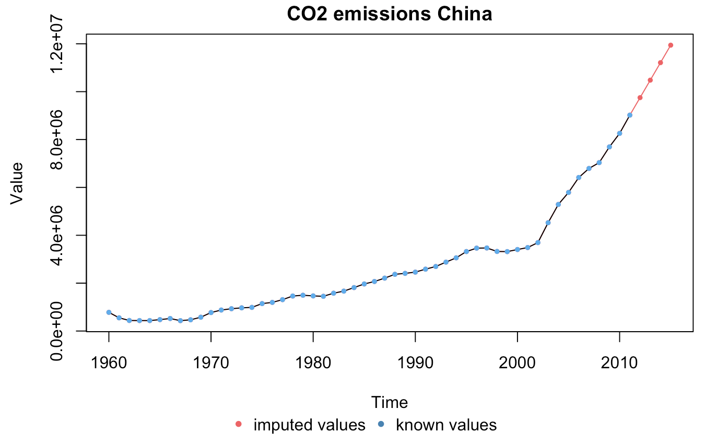
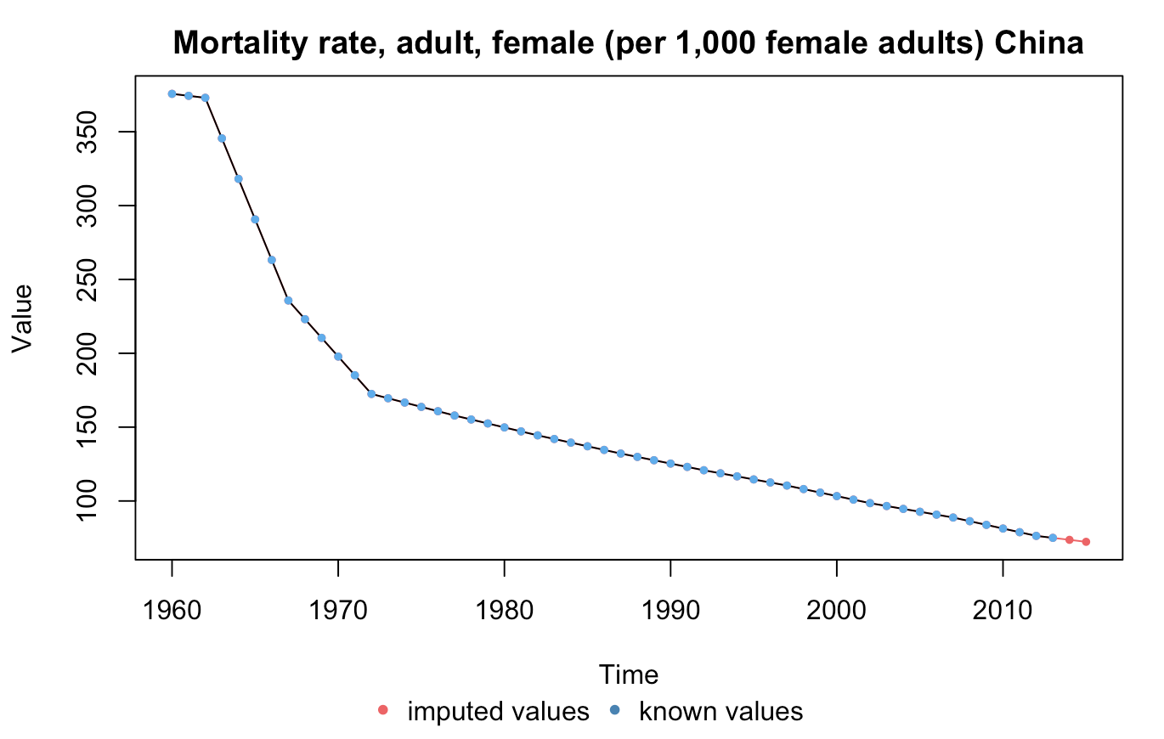
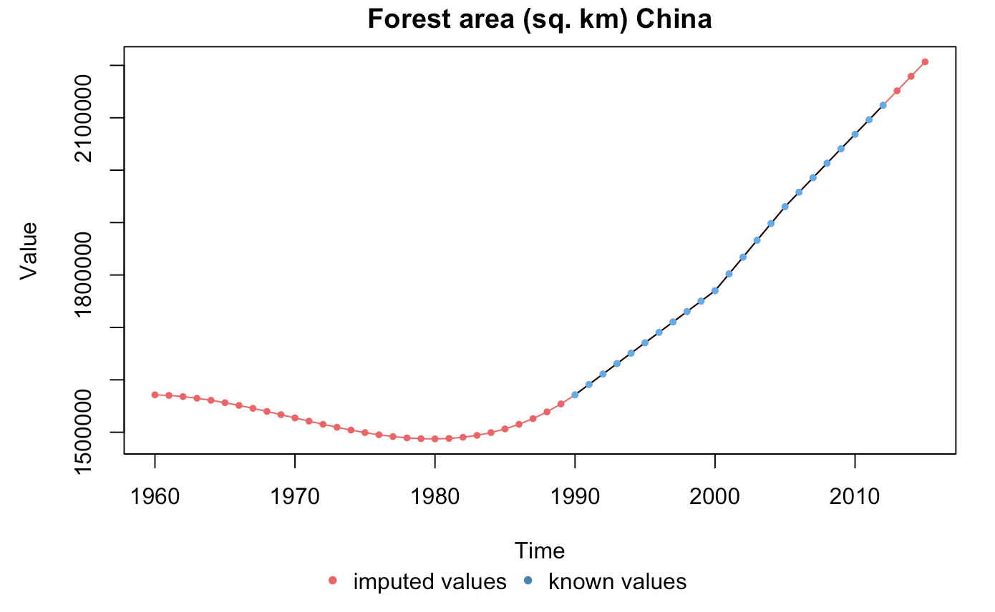
RESULTS:
CHINA

Slide 13
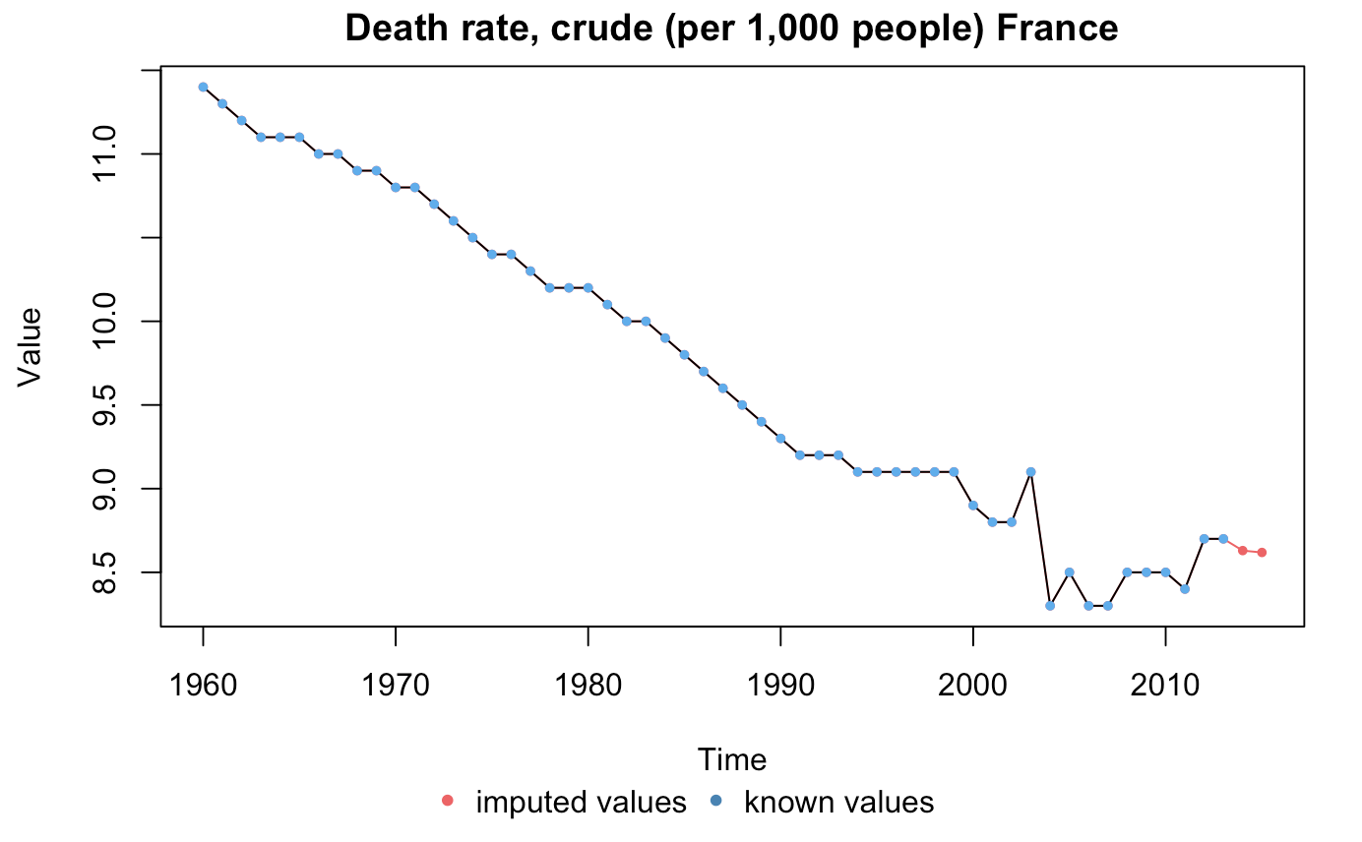
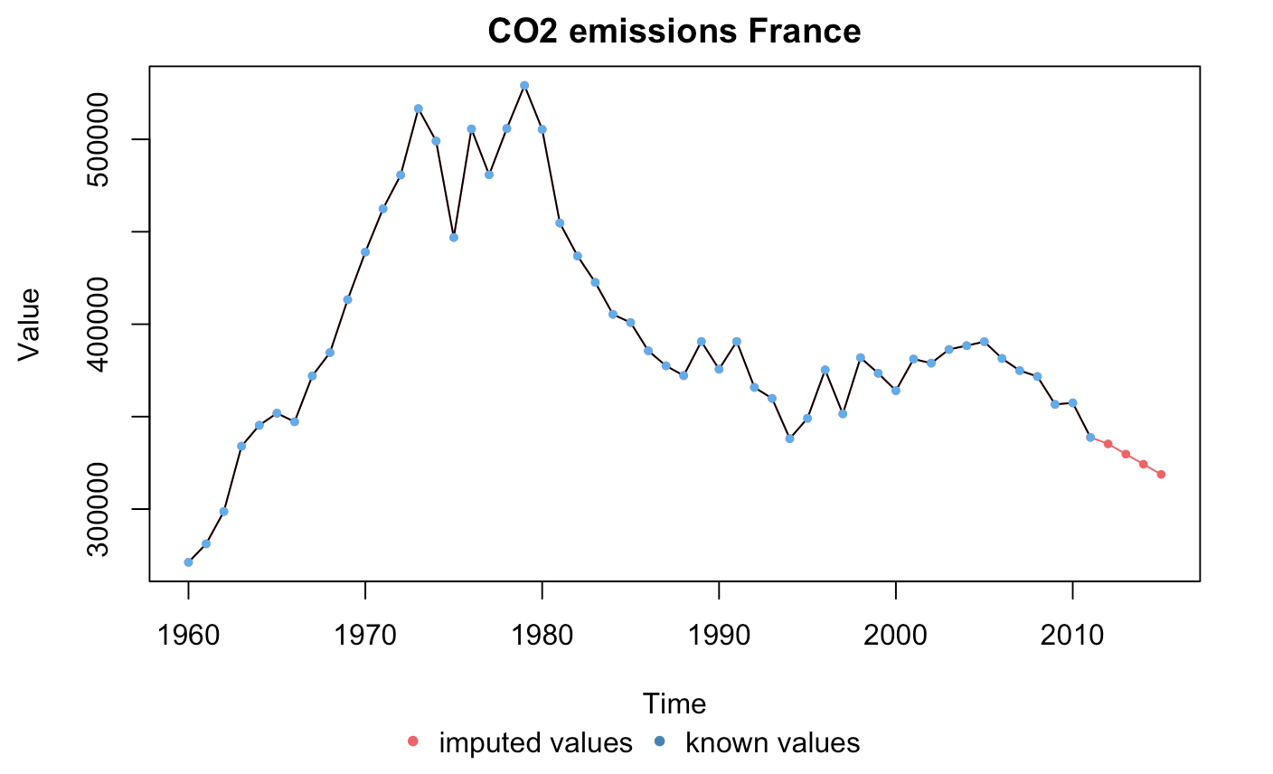
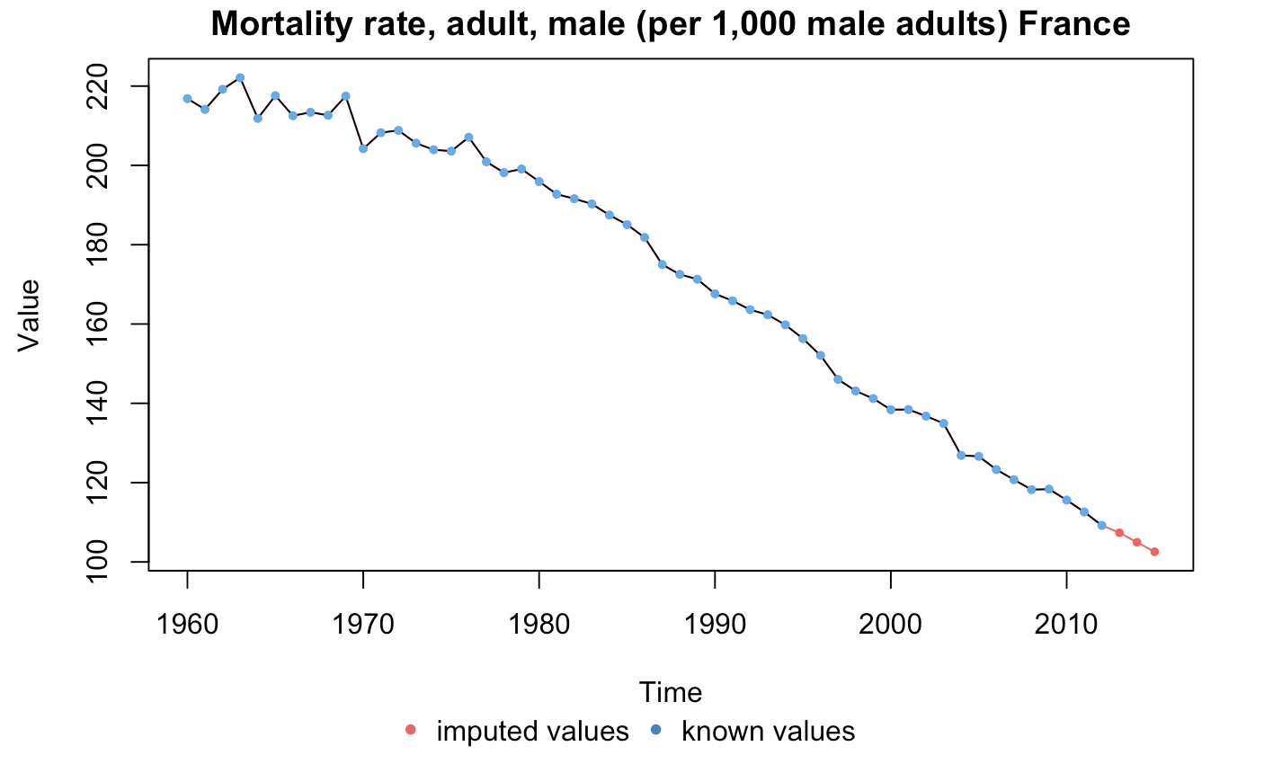
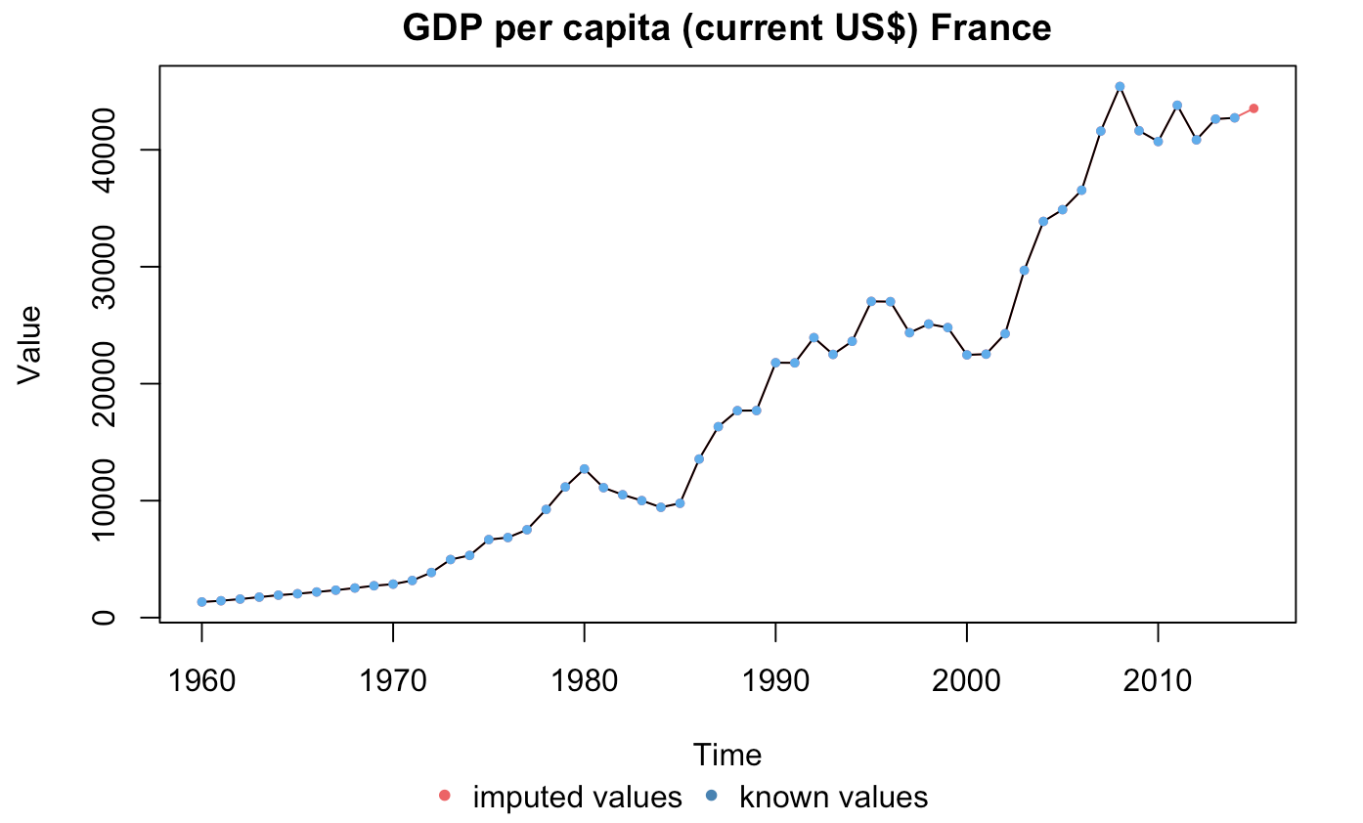
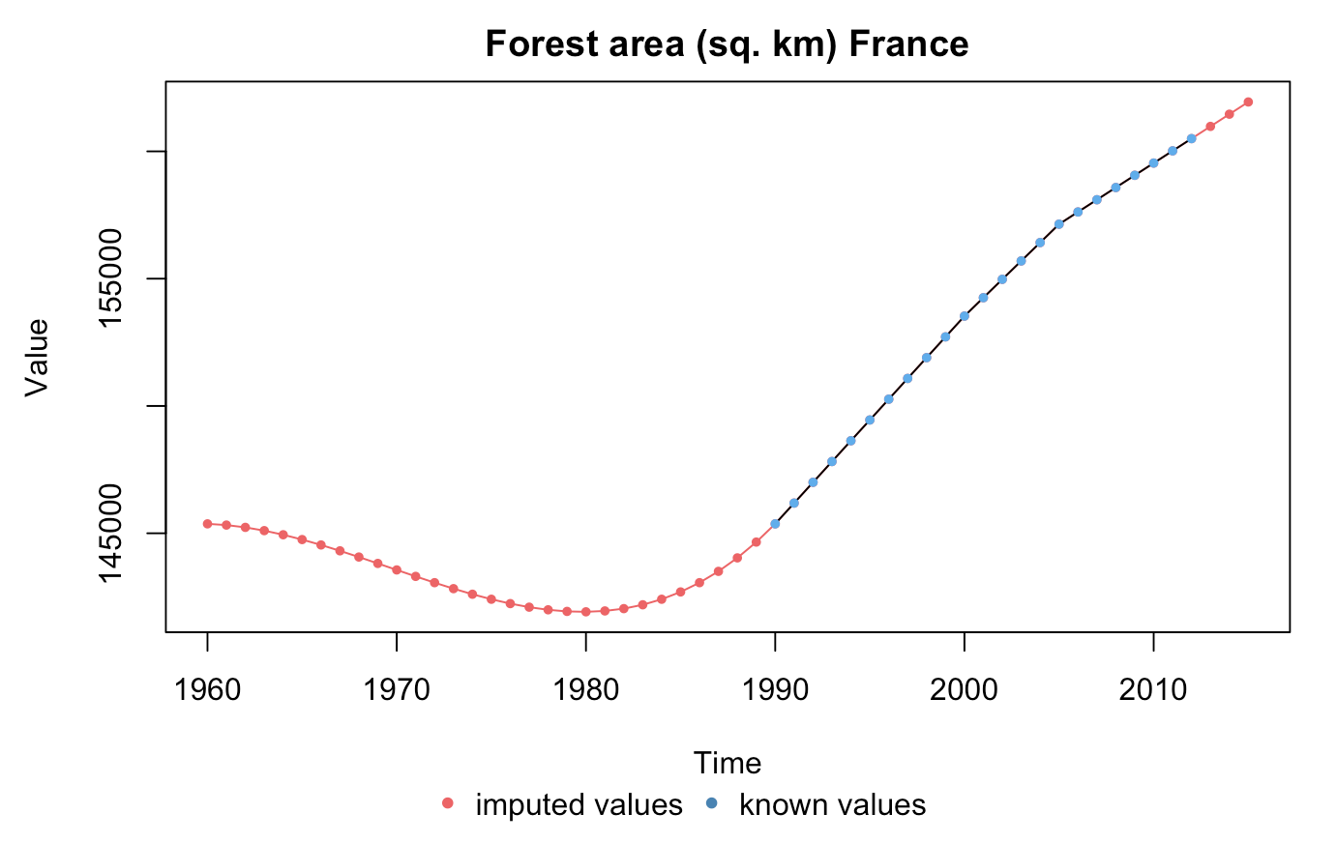
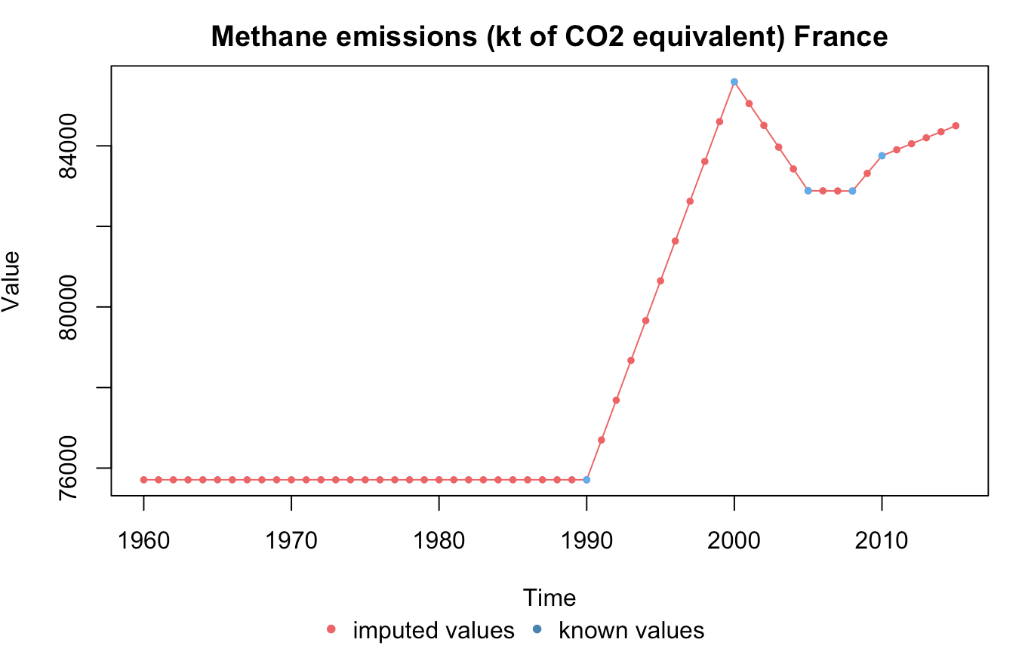
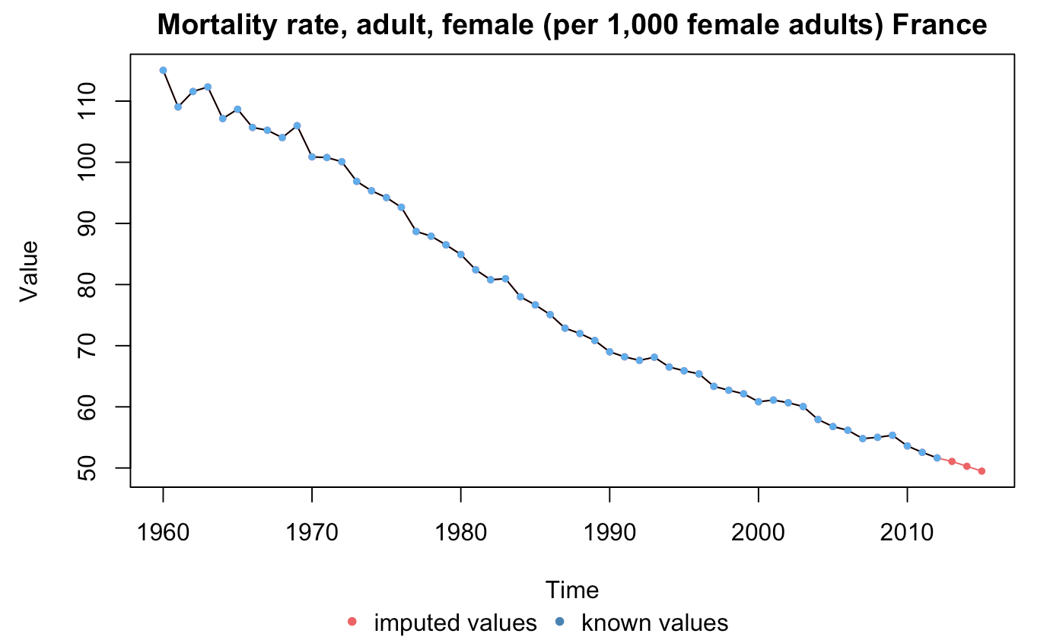
RESULTS:
FRANCE

Slide 14
GRAPH OF EACH INDICATOR (ALL COUNTIRES)
Red points– imputed data with Kalman
Indicator with more than half of the years imputed are discarded

Slide 15
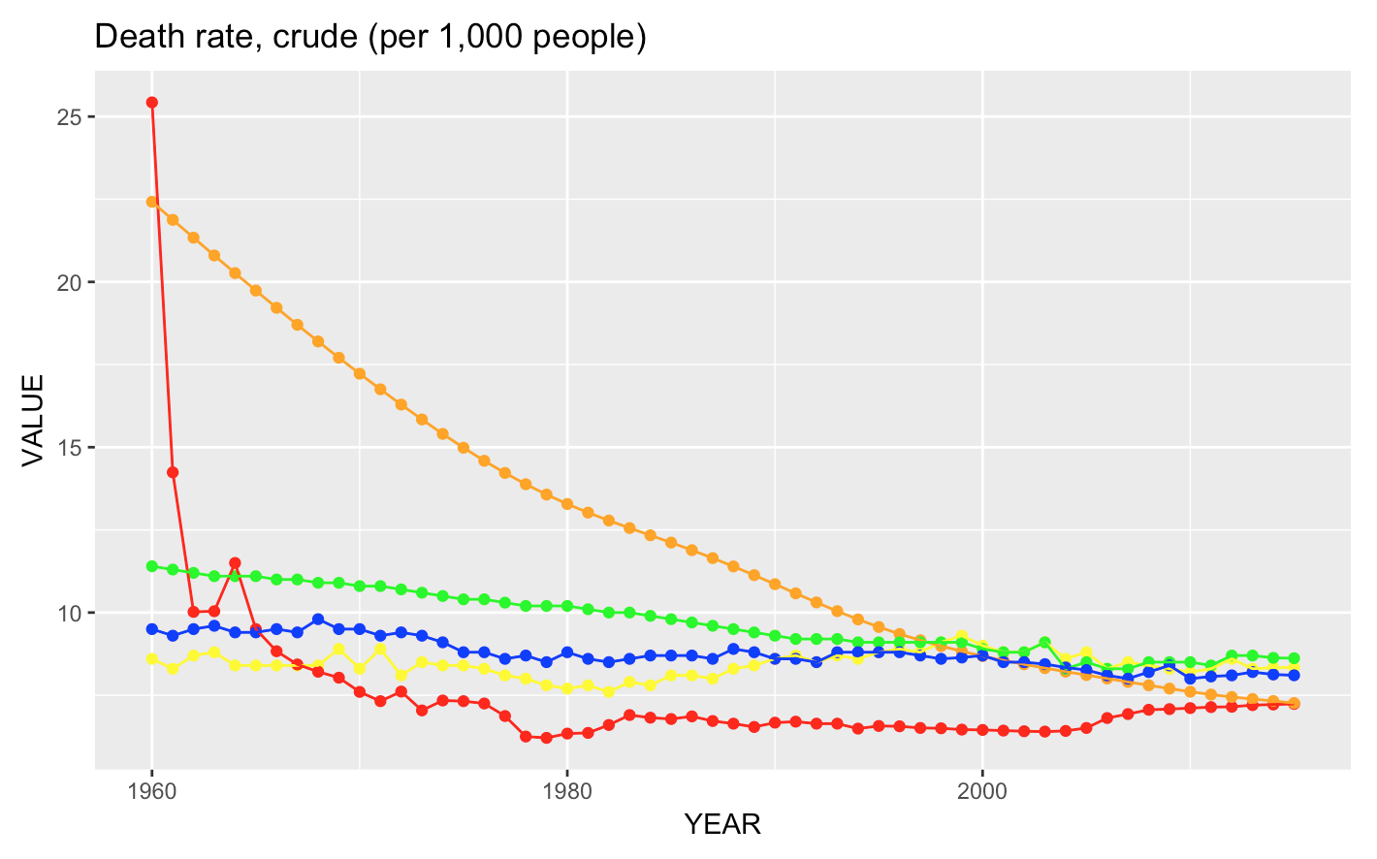
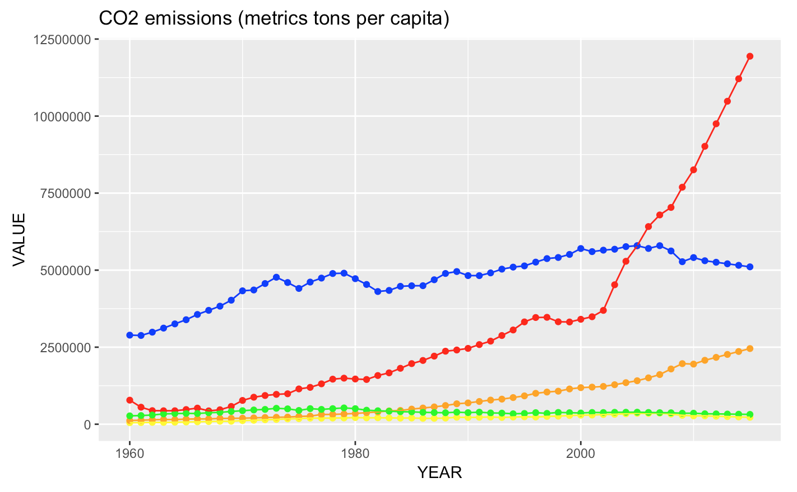
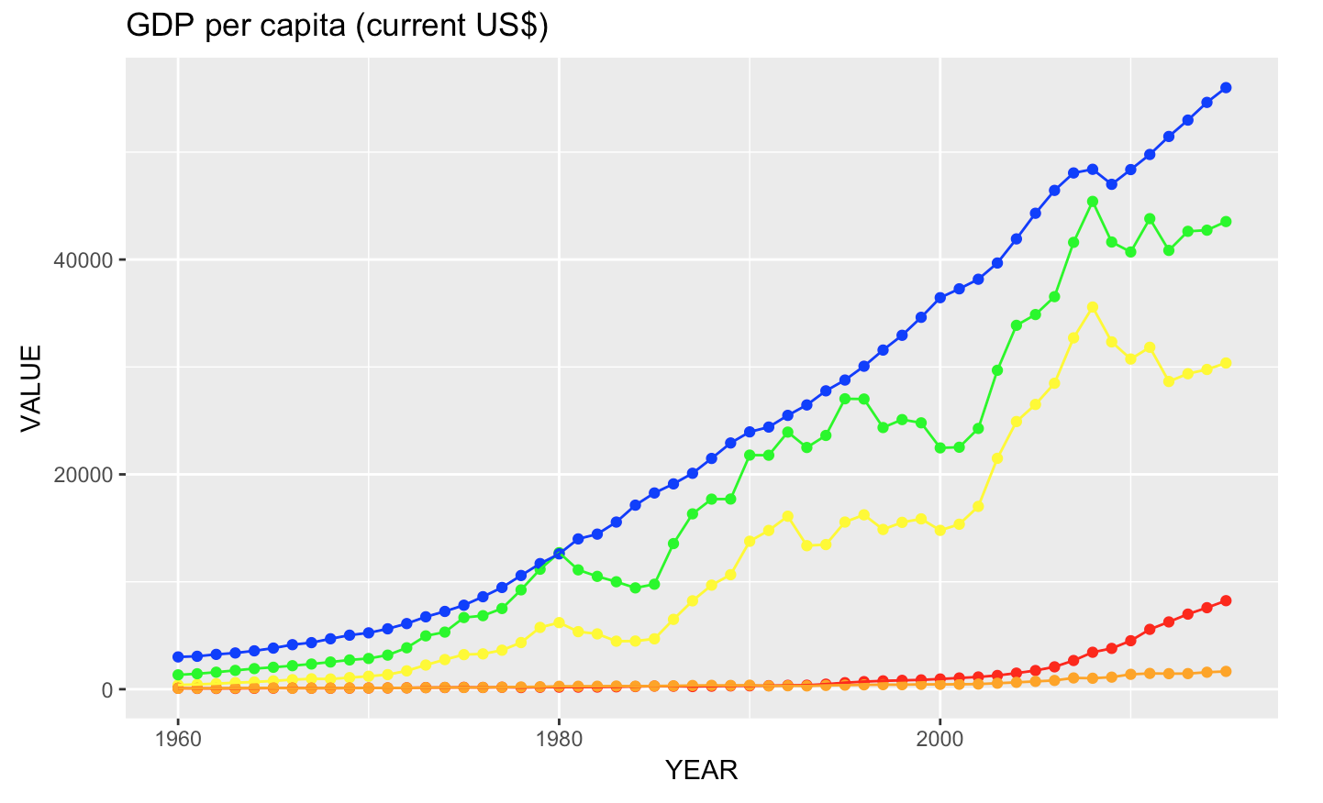
RESULTS: COMPARATION

Slide 16
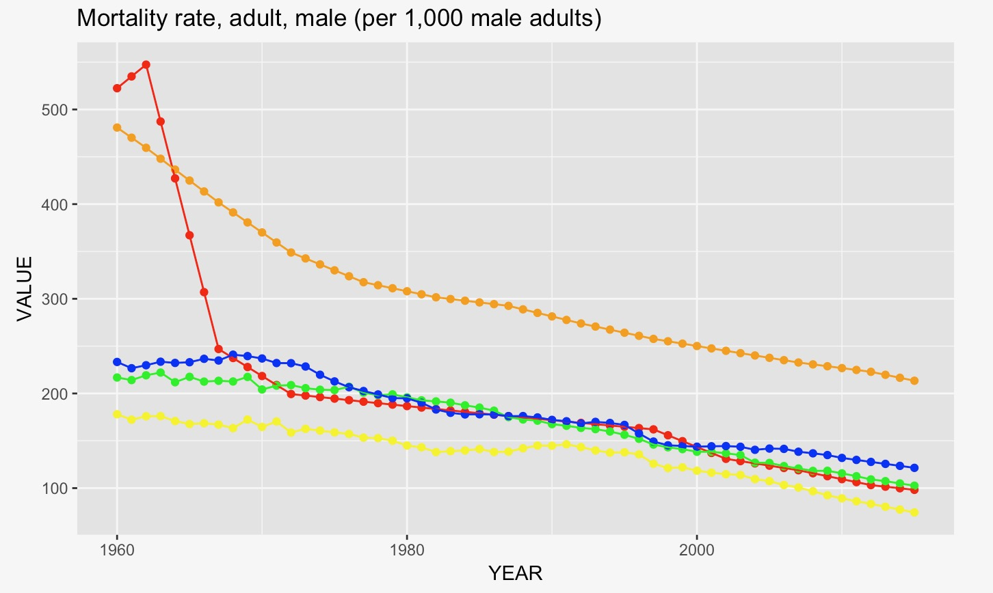
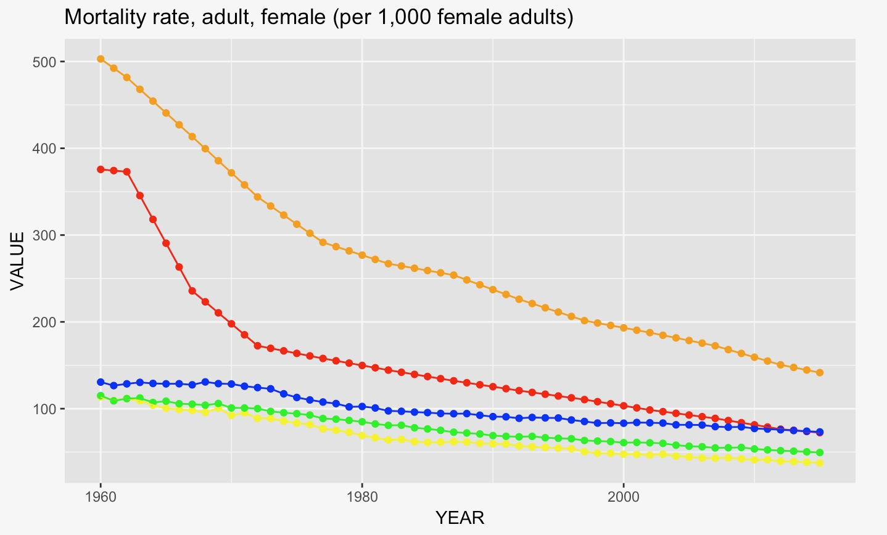
RESULTS: COMPARATION

Slide 17
MODELING
Make data stationary
Create Auto Regressive model, Moving Average and ARIMA

Slide 18
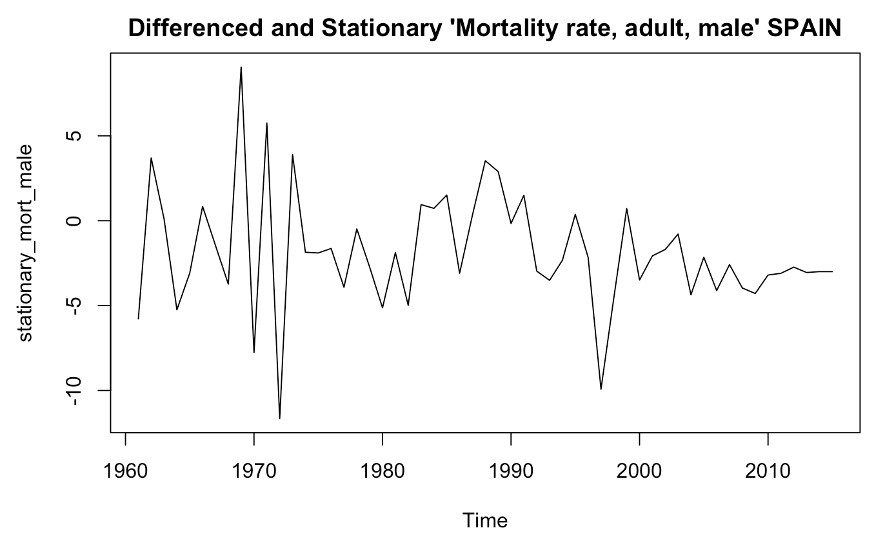
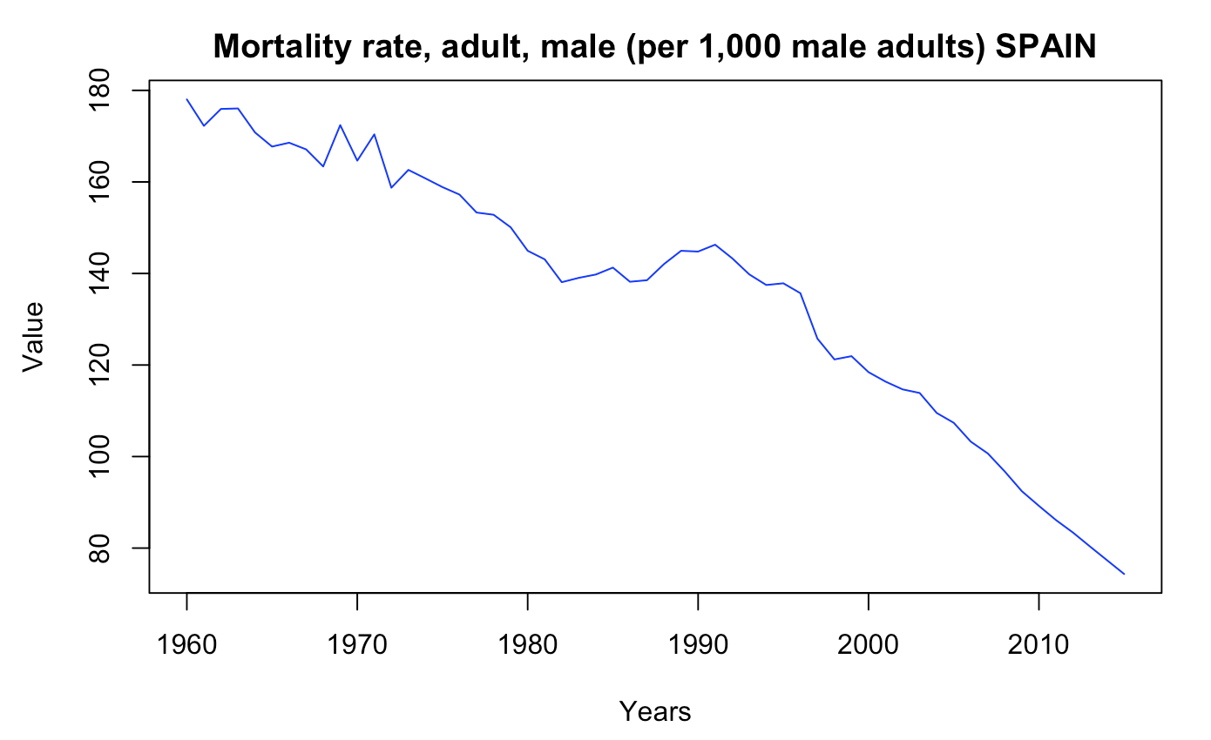
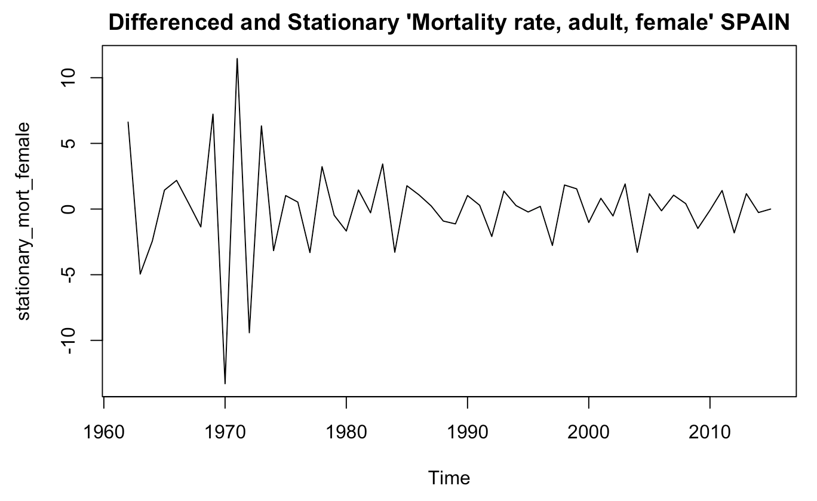
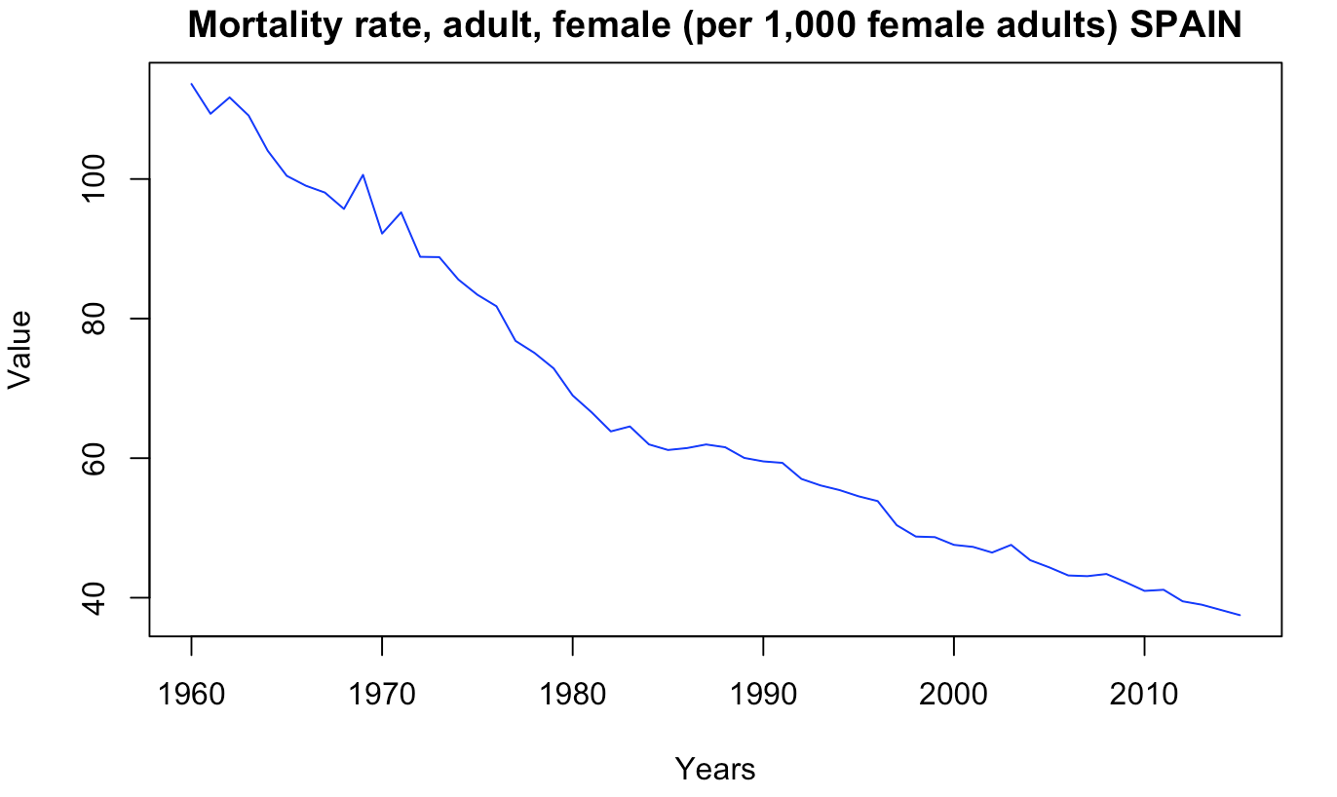
Auto Regressive
Moving Average
ARIMA
Female Mortality
Male Mortality
RESULTS: MODELS
SPAIN
Make data stationary

Slide 19
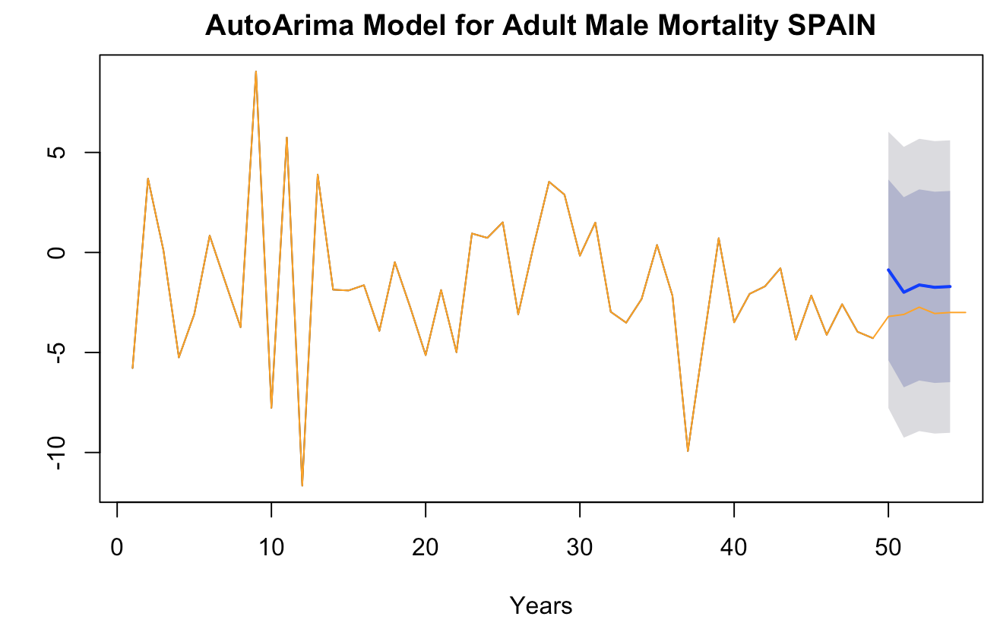
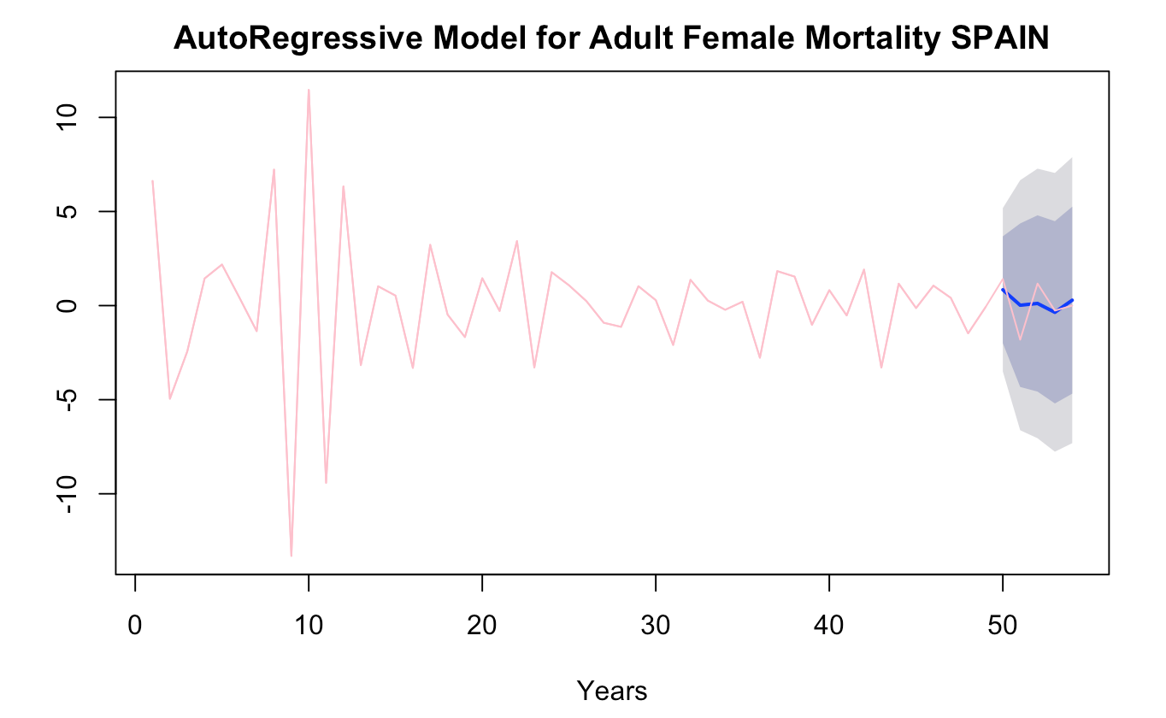
Auto Regressive
Moving Average
ARIMA
Female Mortality
Male Mortality
RESULTS: MODELS
SPAIN

Slide 20
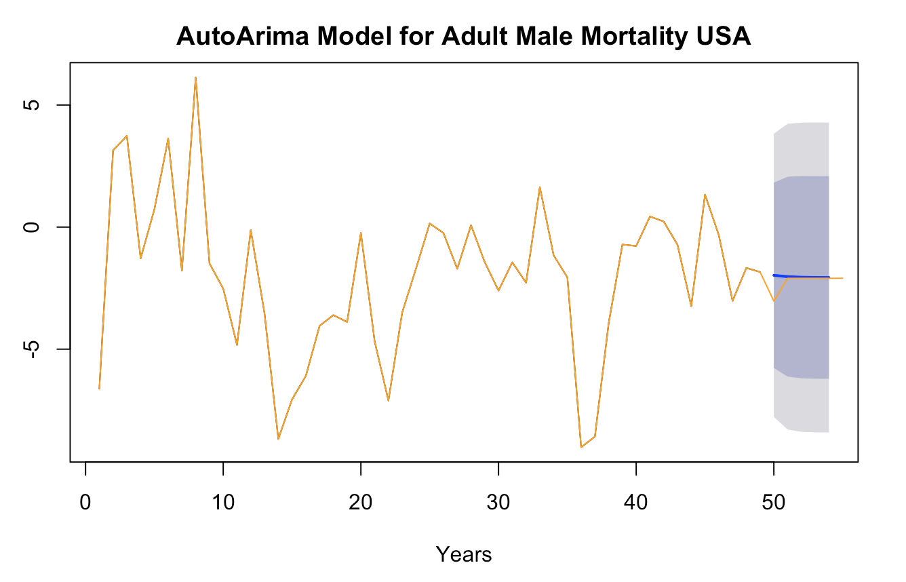
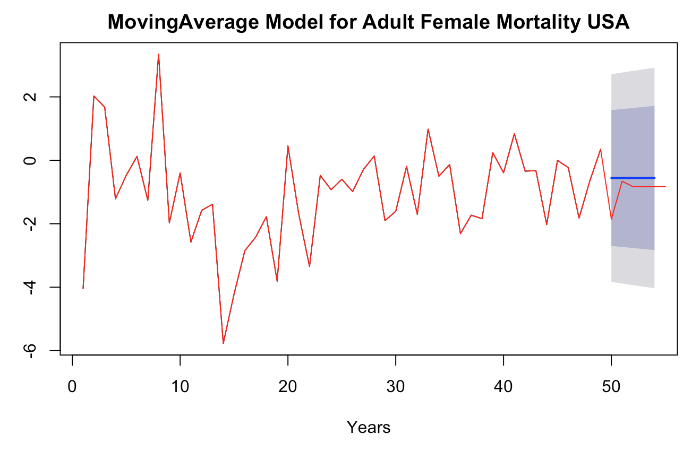
Auto Regressive
Moving Average
ARIMA
Female Mortality
Male Mortality
RESULTS: MODELS
USA

Slide 21
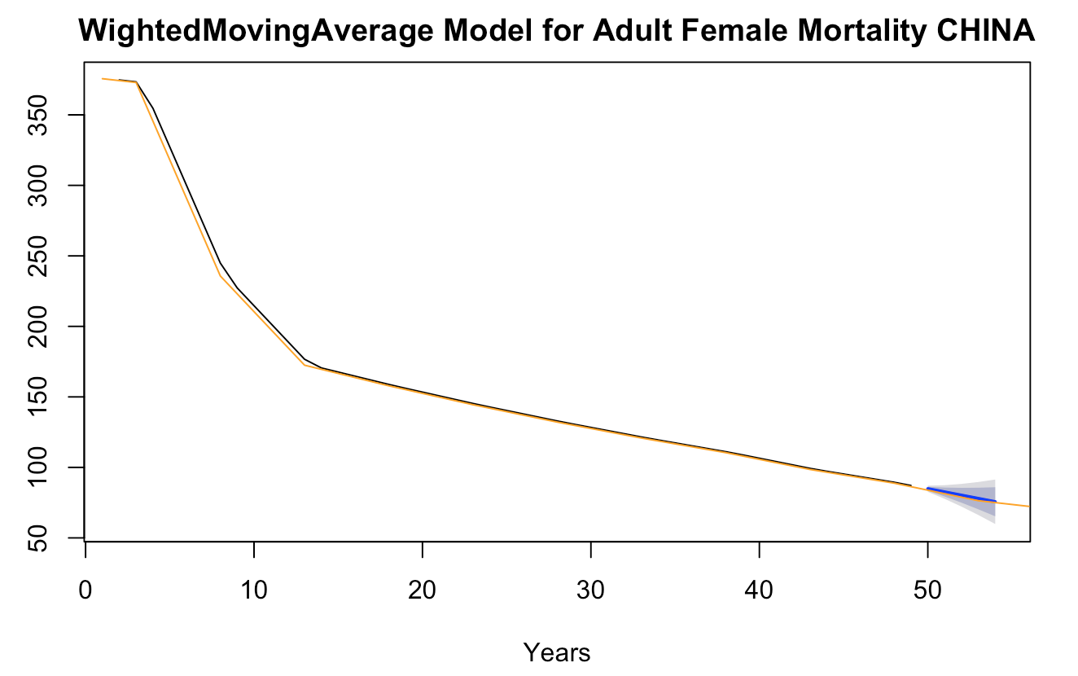

Auto Regressive
Moving Average
ARIMA
Female Mortality
Male Mortality
RESULTS: MODELS
CHINA

Slide 22


Auto Regressive
Moving Average
ARIMA
Female Mortality
Male Mortality
RESULTS: MODELS
INDIA

Slide 23


Auto Regressive
Moving Average
ARIMA
Female Mortality
Male Mortality
RESULTS: MODELS
FRANCE

